Slide 1
PROJECT REPORT ON ORGANIZATION NETWORK SECURITY
BY:-
SAKSHI SRIVASTAVA
NISHI SRIVASTAVA

Slide 2
INTRODUCTION
1.In this project we have shown an organization or a firm network connectivity wit its all sub branches or departments working collaborately as a part of it through various networking devices.
2.This whole organizational setup comprises of its restricted accessibility to their members only which we have implemented in this project.
3. Network security is the practice of preventing and protecting against unauthorized intrusion into corporate networks. As a philosophy, it complements endpoint security, which focuses on individual devices; network security instead focuses on how those devices interact, and on the connective tissue between them.
4.This project inculcates the network security of an organization from various noticed cyber hacks.

Slide 3
RESOURCE LIST
1.Routers
1841 series
2901 series
2911 series
2.Catalyst Switches
2960 series
3.Connectors
RJ-45
4.Cables
Straight t-over cables
Rolled-over cables
Cross-over cables
Console cable
Serial-DCE cables
PC’S and Laptops(end users )
5.Cisco Firewalls
Cisco ASA 5505.
Cisco ASA 5510.
Cisco ASA 5520.

Slide 4
ADVANTAGES OF NETWORK SECURITY
Network Security helps in protecting personal data of clients existing on network.
Network Security facilitates protection of information that is shared between computers on the network.
Hacking attempts or virus / spyware attacks from the internet will not be able to harm physical computers.
External possible attacks are prevented.
Private networks can be provided protection from external attacks by closing them off from internet. Network Security makes them safe from virus attacks, etc.
Notes:
SolarWinds MSP Manager

Slide 5
MODULES
DHCP(Dynamic Host Configuration Protocol)
Routing Protocols
RIP
EIGRP
NAT(Network Address Translation)
ACL(Access-Control List)
Frame –relay
MPLS(Multiple protocol label Switching)
Switching
VLAN(Virtual Local Area Network)
VTP(VLAN Trunking Protocol)

Slide 6
DHCP CONFIGURATION
A DHCP Server is a network server that automatically provides and assign IP addresses, default gateways and other network parameters to client devices.
It relies on the standard protocol known as Dynamic Host Configuration Protocol or DHCP to respond to broadcast queries by clients.
Without it , the network administrator has to manually set up every client that joins the network.
DHCP servers assign each client with unique dynamic IP address, which changes when the client’s lease for that IP address has expired.

Slide 7
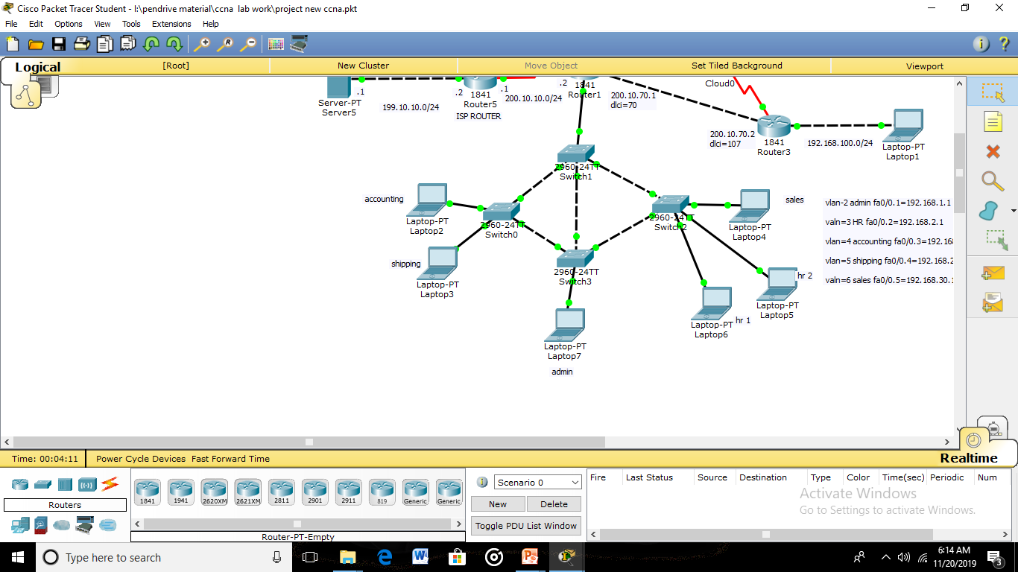
DHCP CONFIGURED SYSTEMS

Slide 8
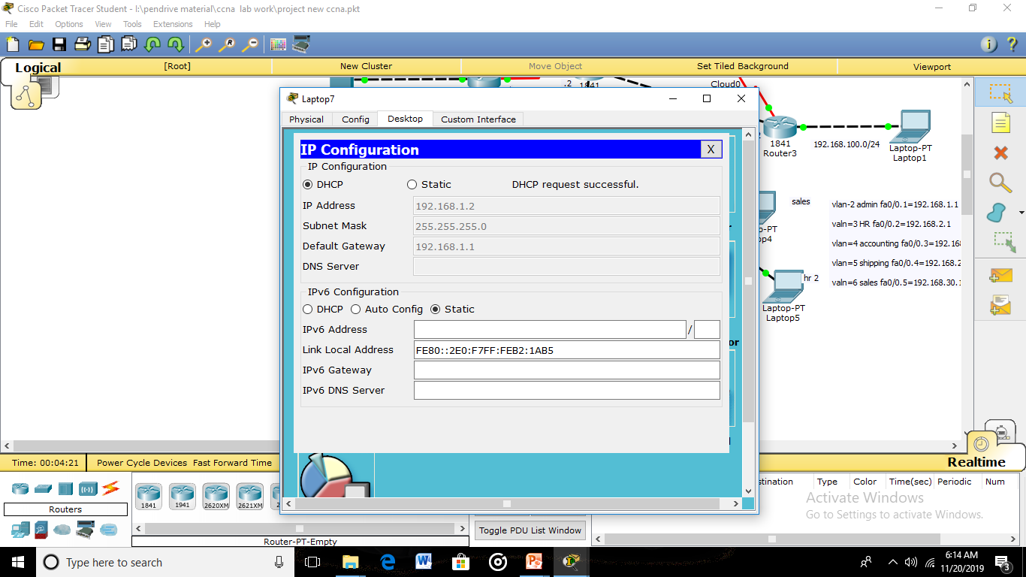
DHCP CONFIGURED IP’S

Slide 9
ROUTING PROTOCOLS
RIP(ROUTING INFORMMATION PROTOCOL)
RIP is an open standard protocol(any firm can use it).
For having connectivity with destination we use routing protocols.
RIP sends updates on routing(every 30 second).
RIP uses Bellman-ford algorithm to determine best path.

Slide 10
ROUTING PROTOCOLS
EIGRP(EXTENDED INTERIOR GATEWAY PROTOCOL)
Enhanced Interior Gateway Routing protocol is a distance-vector routing protocol that is used on computer network for automating routing decisions and configurations.
EIGRP is used on a router to share routes with other routers within the same autonomous system.
Unlike RIP, EIGRP only sends incremental updates, reducing the workload on router and the amount of data that needs to be transmitted.

Slide 11
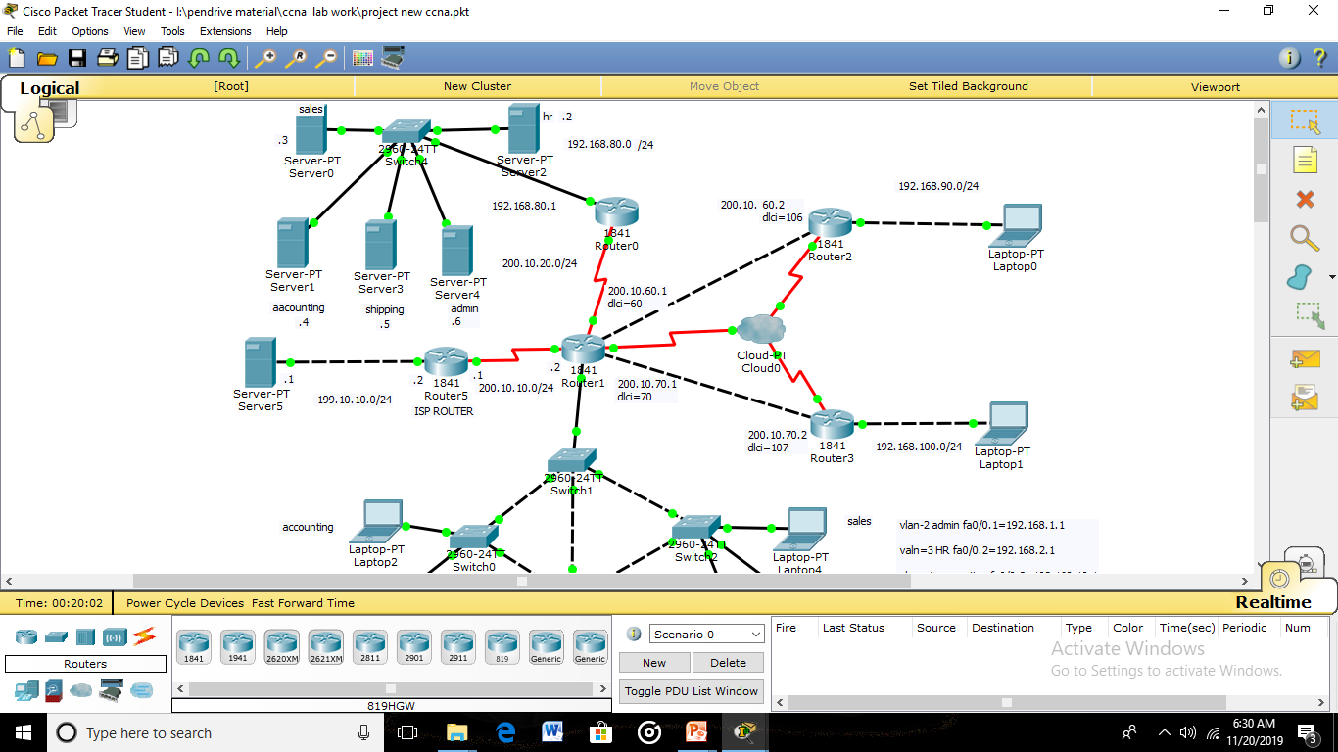
EIGRP PROTOCOL ENABLED ROUTERS

Slide 12
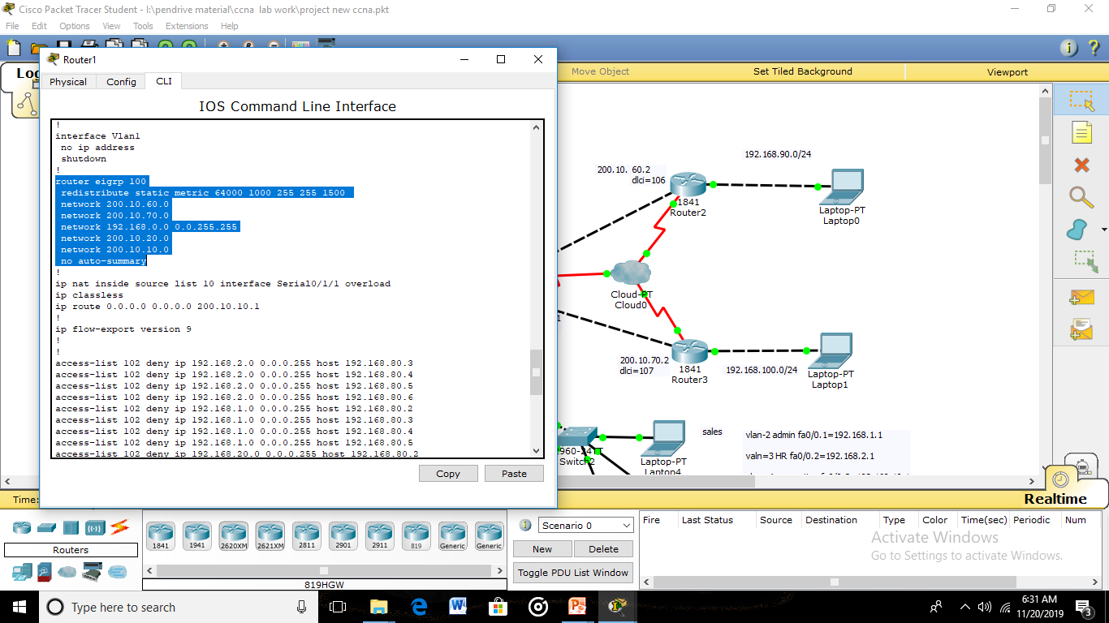
EIGRP COMMANDS

Slide 13
NAT (NETWORK ADDRESS TRANSLATION)
Network Address Translation (NAT) is the process where a network device, usually a firewall, assigns a public address to a computer (or group of computers) inside a private network. The main use of NAT is to limit the number of public IP addresses an organization or company must use, for both economy and security purposes.
The most common form of network translation involves a large private network using addresses in a private range (10.0.0.0 to 10.255.255.255, 172.16.0.0 to 172.31.255.255, or 192.168.0 0 to 192.168.255.255).

Slide 14
NATING

Slide 15
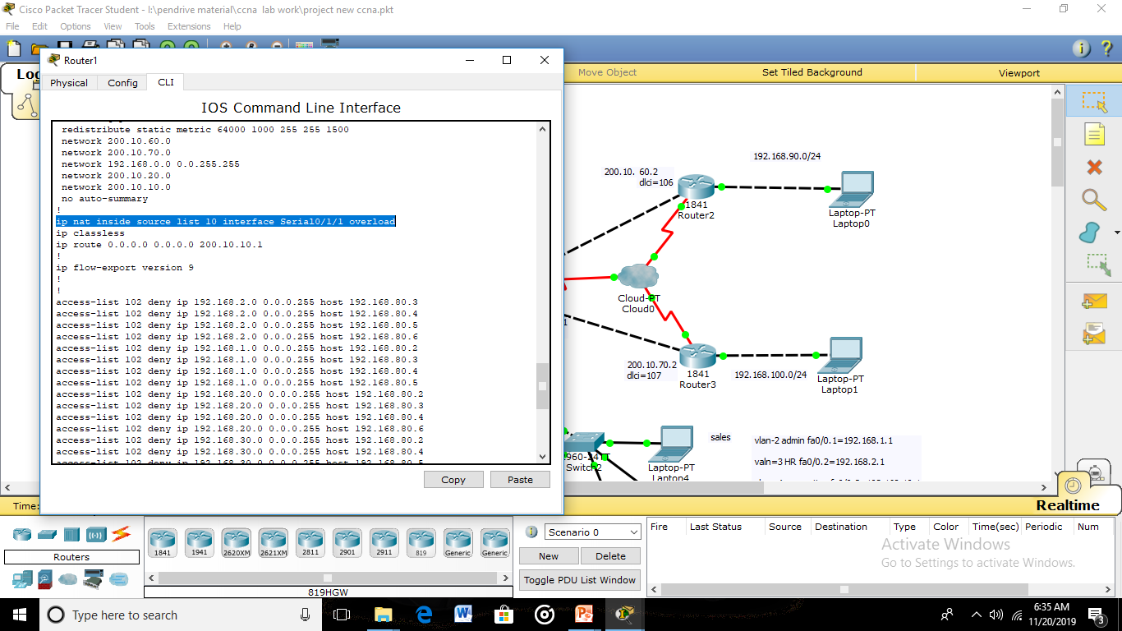
NAT COMMAND

Slide 16
ACL(ACCESS-CONTROL LISTS)
A network access control list (ACL) is an optional layer of security for your VPC that acts as a firewall for controlling traffic in and out of one or more subnets. You might set up network ACLs with rules similar to your security groups in order to add an additional layer of security to your VPC.
There are several types of access control lists and most are defined for a distinct purpose or protocol. On Cisco routers, there are two main types: standard and extended. These two types are the most widely used ACLs

Slide 17
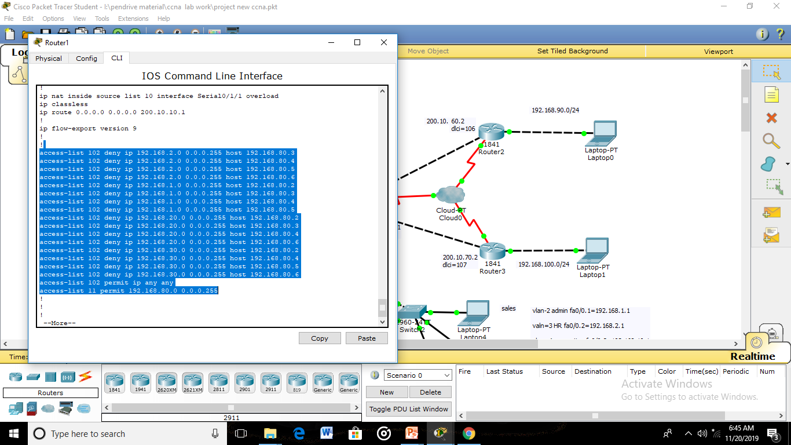
STANDARD AND EXTENDED ACL’S

Slide 18
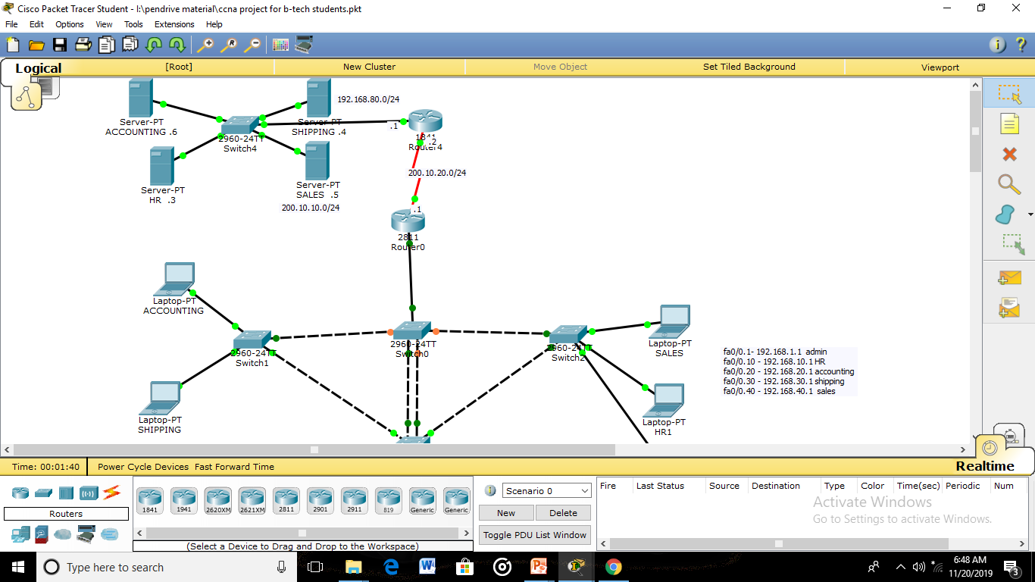
ACL APPLIED ROUTERS

Slide 19
FRAME-RELAY
Frame relay is a technique of creating connectivity to remote locations where our users can not access through lease lines. So basically it creates a virtual connectivity to remote locations by simply forming a VLAN network through which its accessibility can be made easier for end users and they can easily connect to remote locations.
Frame relay technique uses a tag value called as DLCI that is given by ISP. It doesn’t checks IP header packet and directly sends to the destination routers.
For point to point communication it creates a virtual link.

Slide 20
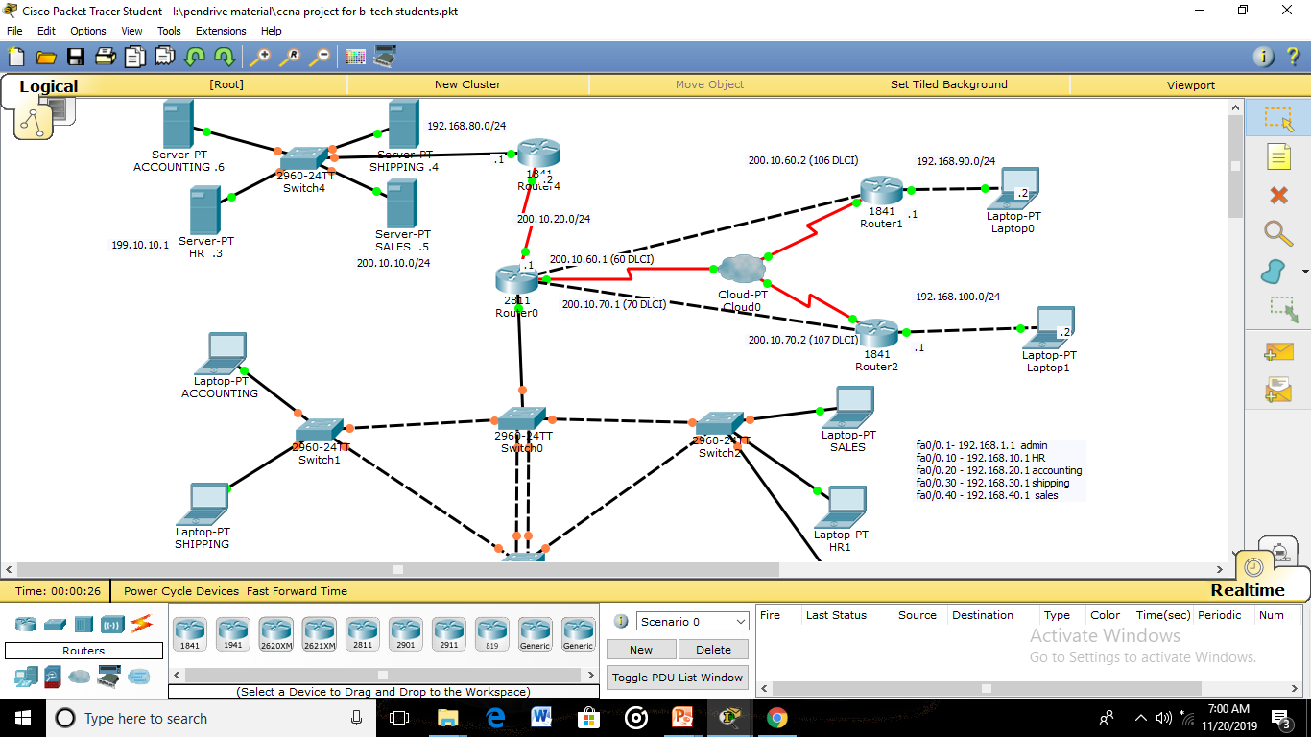
FR SWITCH

Slide 21
VLAN & VTP
A VLAN is a virtual local area network designed to divide the multiple broadcasts domains of switches.
It has 3 modes- server mode, client mode, transparent mode.
COMMANDS:-
Router(config)#vlan 2
Router(config)#name sales
VLAN Trunking Protocol (VTP) is a Cisco proprietary protocol that propagates the definition of Virtual Local Area Networks (VLAN) on the whole local area network. To do this, VTP carries VLAN information to all the switches in a VTP domain.

Slide 22
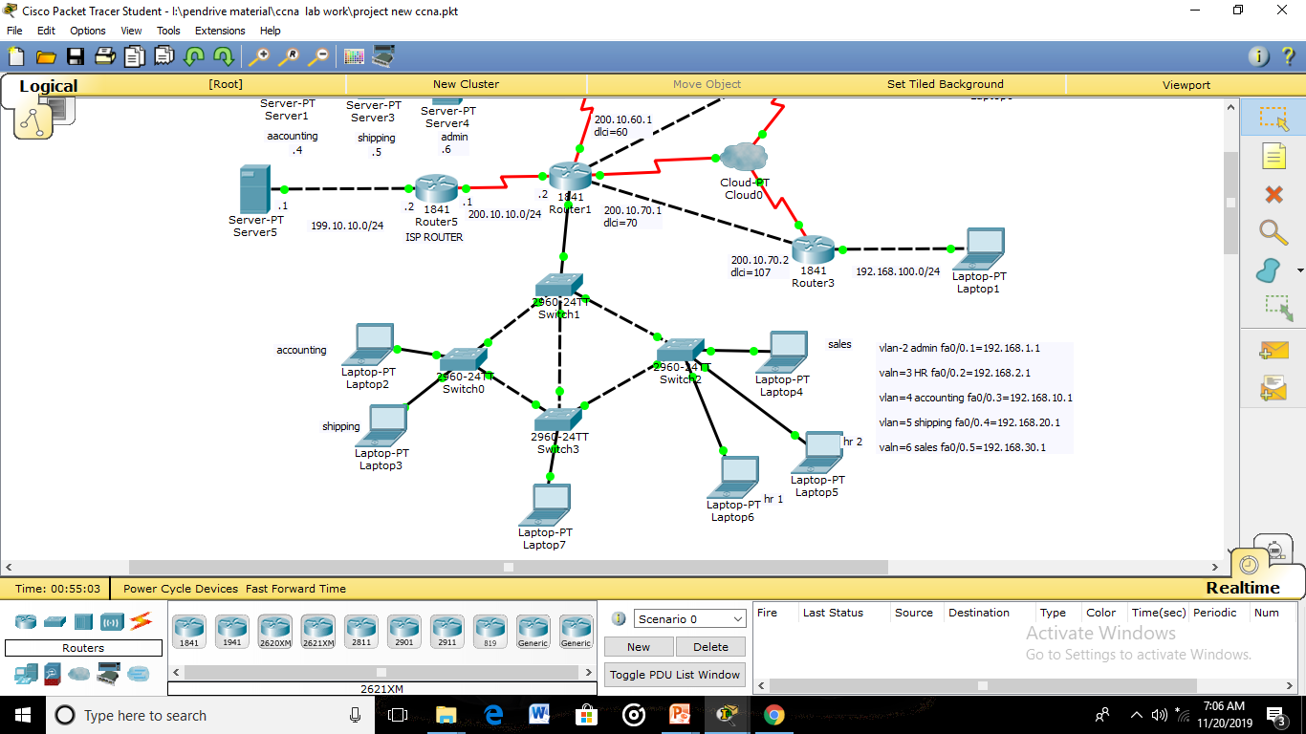
VLAN & VTP CREATED ON SWITCHES

Slide 23
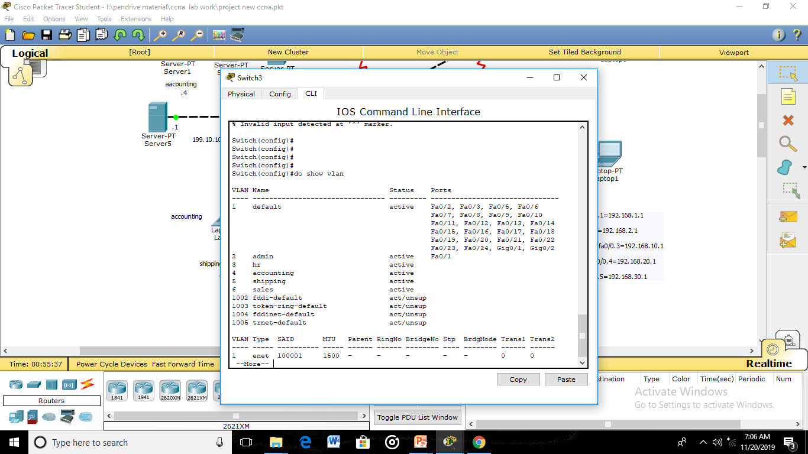
DIFFERENT VLAN’S CREATED

Slide 24
MPLS (MULTIPLE PROTOCOL LABEL SWITCHING)
Multiprotocol Label Switching (MPLS) is a routing technique in telecommunications networks that directs data from one node to the next based on short path labels rather than long network addresses, thus avoiding complex lookups in a routing table and speeding traffic flows.
The labels identify virtual links (paths) between distant nodes rather than endpoints. MPLS can encapsulate packets of various network protocols, hence the "multiprotocol" reference on its name.
MPLS supports a range of access technologies, including T1/E1, ATM, Frame Relay, and DSL. MPLS is scalable and protocol-independent.
MPLS operates at a layer that is generally considered to lie between traditional definitions of OSI Layer 2 (data link layer) and Layer 3 (network layer), and thus is often referred to as a layer 2.5 protocol.

Slide 25
ROLE OF FUNCTIONING OF MPLS
A number of different technologies were previously deployed with essentially identical goals, such as Frame Relay and ATM. Frame Relay and ATM use "labels" to move frames or cells throughout a network.
The header of the Frame Relay frame and the ATM cell refers to the virtual circuit that the frame or cell resides on.
The similarity between Frame Relay, ATM, and MPLS is that at each hop throughout the network, the ―label‖ value in the header is changed. This is different from the forwarding of IP packets' technologies have evolved with the strengths and weaknesses of ATM in mind.
At the same time, MPLS attempts to preserve the traffic engineering (TE) and out-of-band control that made Frame Relay and ATM attractive for deploying large-scale n.

Slide 26
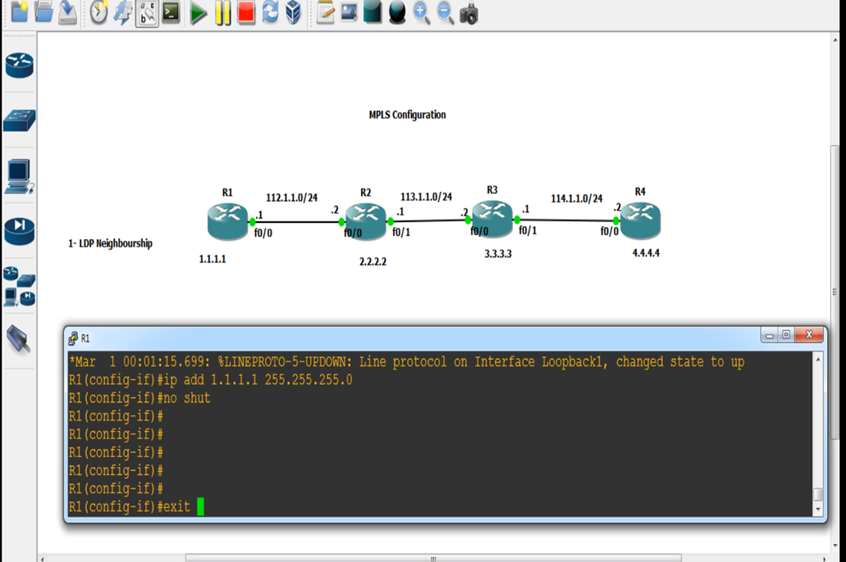
MPLS ENABLED ROUTERS

Slide 27
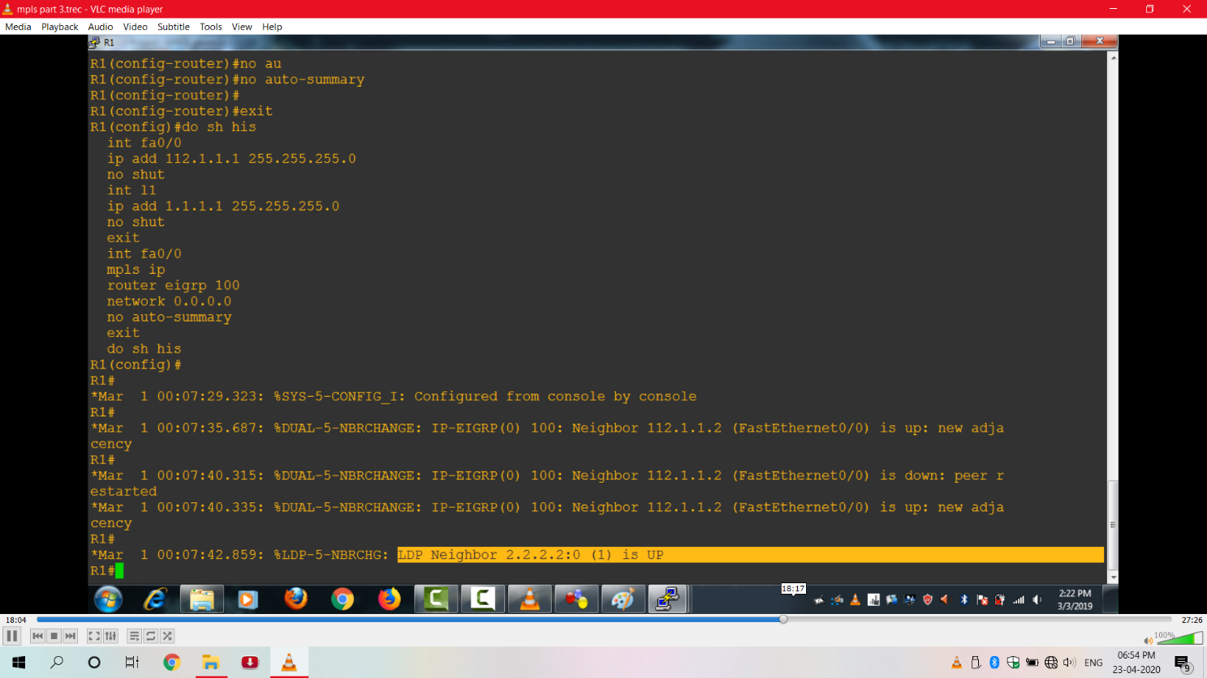
MPLS INFO FROM EACH ROUTER

Slide 28
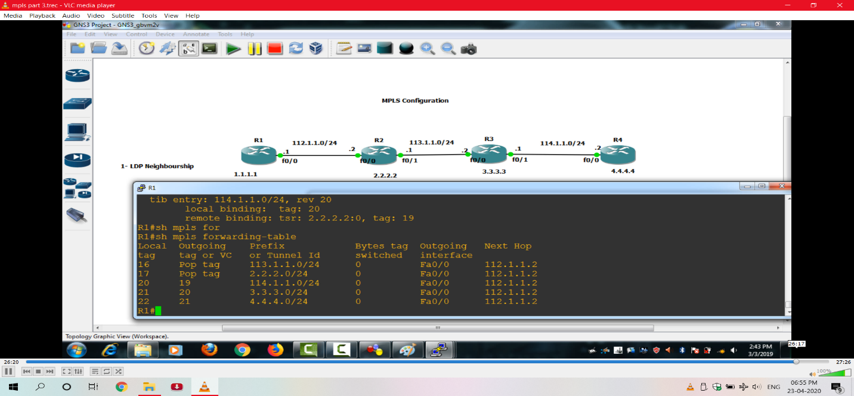
MPLS FUNCTIONING

Slide 29
FUTURE SCOPE
- Enterprise connectivity is exploding, driven by globalization, virtualization and social computing. As corporate perimeters dissolve, the network security focus switches towards app and data-level security solutions.
- Who needs network security? Why don't we just build encryption and antimalware protection into end-points and simply enjoy open networks? From a security perspective that's always best and it's in line with the Jericho Forum vision. But in the real world it's not so simple.
- One of the biggest security concerns today is the insider threat. In response to this, you can deploy many interesting techniques in networks to detect anomalous user behavior. Valuable intelligence can be derived by profiling, fusing and mining message content, traffic patterns or IT activity.
- The future of network security might be far from clear-cut. One thing is clear - it will certainly be richer and more sophisticated than we've seen so far. Determining how to plan for a business environment in which everyone is connected and security expectations are high is not trivial. We all have to do it.

Slide 30
Thank You!

